Slide 1
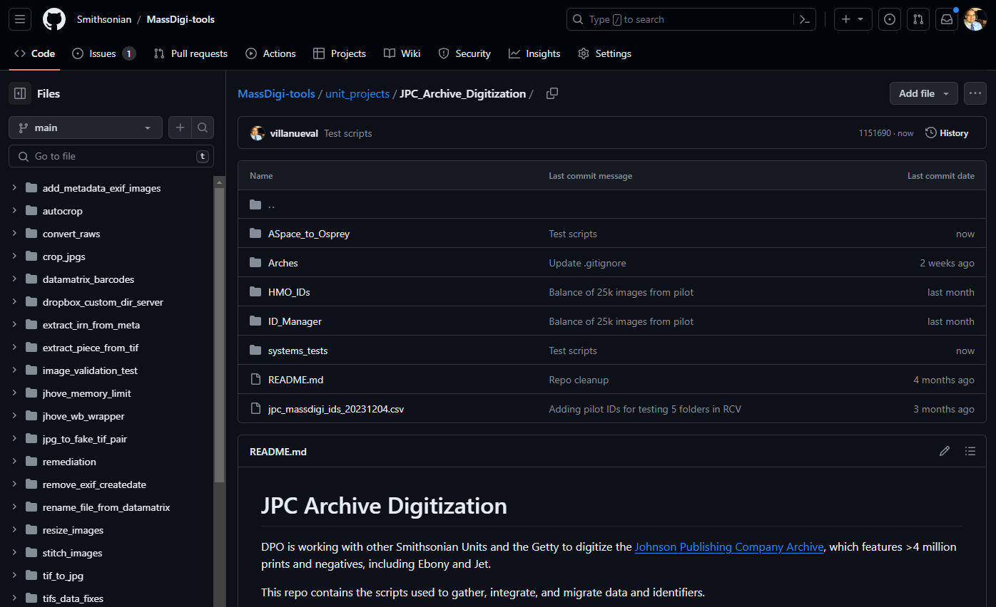

Slide 2
Timeline of DPO Work
Learning ASpace, ID Manager, Arches
Design/code ID generation
Develop scripts
Prepare and Save PrePilot Test Images to DAMS
RCV Made Available
Meeting in DC
PrePilot Abandoned
Getty Notice IDs
in Wrong Format
PrePilot Data Delivered to
ID Manager/Arches
All Pilot Loaded
to IDManager/Arches (x2)
5 Archival Items Reloaded
Meeting in LA
5 Archival Items Loaded
Feb 2023
Apr 2023
Jun 2023
Aug 2023
Oct 2023
Dec 2023
Feb 2024
Pilot Digitization

Slide 3
Turnaround by DPO
Feb 8 – DPO detects an error in the sequence of items
“Item 0001 [appears as] item 8 in the folder” – Luis in Slack
Diagnosed within minutes of detecting issue
Error due to an autosorting statement in the query
Feb 13 – DPO loads all ID’s with the correct sequence
50,100 IDs to ID Manager
25,050 Records to Arches
2 business days

Slide 4
“Slow” Script
Explained in meetings:
Feb 6, JPC Tech Working Group
Jeanine explained; Isabel and Andrew present
Feb 12 meeting (organized by Michelle)
Luis explained; Andrew present
SI -> Getty process changed at least 4x by Getty
Kept scripts simple to reduce time in edits

Slide 5
“Slow” Script Estimates in Parallel
ID’s of 25k images to ID Manager (50k IDs):
X4: 74 mins
X8: 37 mins
X16: 19 mins
Not applicable for Pilot/Production
Reload of all Pilot data

Slide 6
Daily Estimates for Production
1k images/day (~160GB):
Transfer from vendor to HDC (~40MB/sec): 70 mins
Transfer to Hydra (limited to 20MB/sec): 140 mins
Ingest to Osprey (in Hydra using 32 cores): 10 mins
Visual QC by archivists: variable
Transfer to DAMS hotfolder (~65MB/sec): 35 mins
Creating ID’s in ID Manager/Arches: 20 mins
Only manual step, to automate in Production
Notes:
DPO can deliver in 24 hrs
Hydra:
- Sync between nearline and working: 36 mins
- Osprey: 10 mins
Limiting factors:
- Parallel stations by vendor
- QC by archivists
- DAMS ingest, can be reduced
- Hydra speed can be increased
What estimates we don’t have?
- Archive processing
- Surfacing of images via IIIF
- Andrew sending IIIF IDs to ID Manager
- Loading data to RCV, which is a manual process

Slide 7
Daily Estimates
DPO can deliver in < 5 hrs
Visual QC not included
Can keep up with ~5x output by vendor
Getty surfacing to RCV is not automatic
Notes:
DPO can deliver in 24 hrs
Hydra:
- Sync between nearline and working: 36 mins
- Osprey:
Limiting factors:
- Parallel stations by vendor
- QC by archivists
- DAMS ingest, can be reduced
- Hydra speed can be increased
What estimates we don’t have?
- Archive processing
- Surfacing of images via IIIF
- Andrew sending IIIF IDs to ID Manager
- Loading data to RCV, which is a manual process

Slide 8
Long-Running Scripts
Hydra Queues in 3 Time Limits:
7 hours
6 days
30 days
OpenStreetMaps (from Geofabrik)
3 days to process all continents

Slide 9
